Slide 1
Smart Home Intrusion Detection Using
Network Intrusion Detection
Techniques
Manuel Munoz
Interim Presentation

Slide 2

Presentation Objectives
Share
status
Get
feedback

Slide 3
Motivation
Increase of break-ins
Increased ubiquity of sensors/actuators on households
Parents want cameras on all the time, teens are not comfortable with that.

Slide 4
Problem Statement
Is it possible to implement a non-invasive smart home system?
Find parallels between intrusion detection on networks and the smart home

Slide 5


iOSPraktikum WS2014

Slide 6
Proposed Solution
Build an non-invasive, extensible smart home system based on network intrusion detection techniques.

Slide 7
Proposed Solution
Build an non-invasive, extensible smart home system based on network intrusion detection techniques.

Slide 8
Proposed Solution
Build an non-invasive, extensible smart home system based on network intrusion detection techniques.

Slide 9
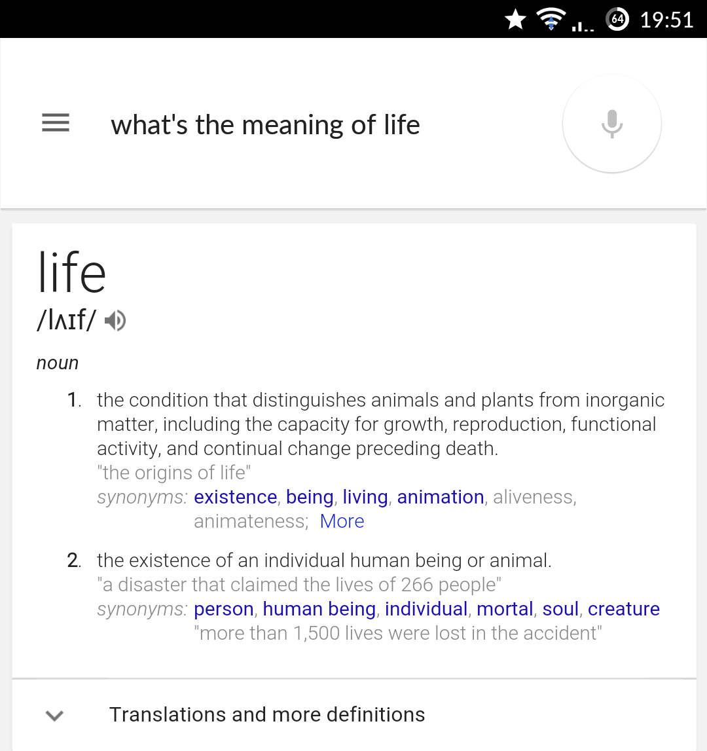
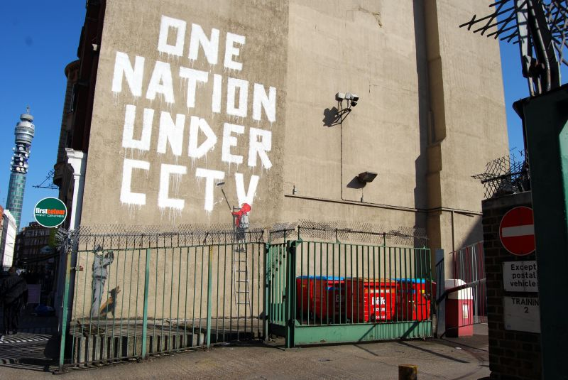
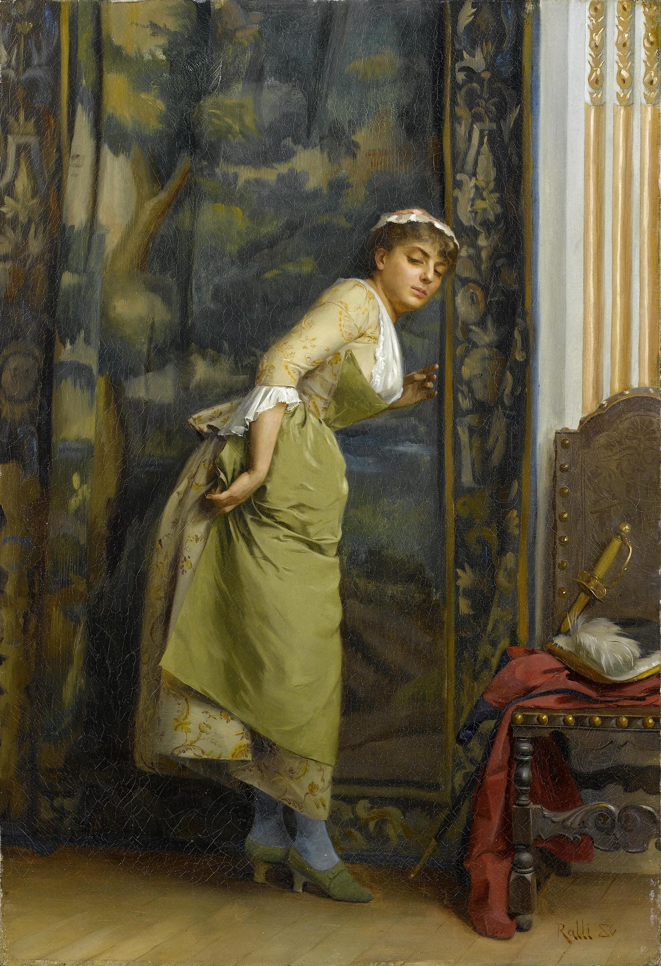
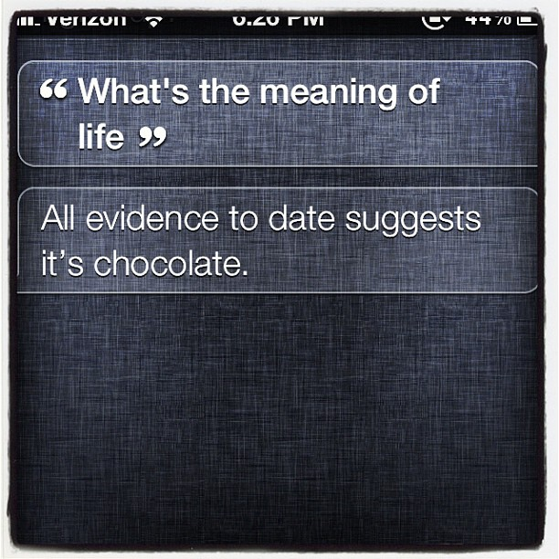
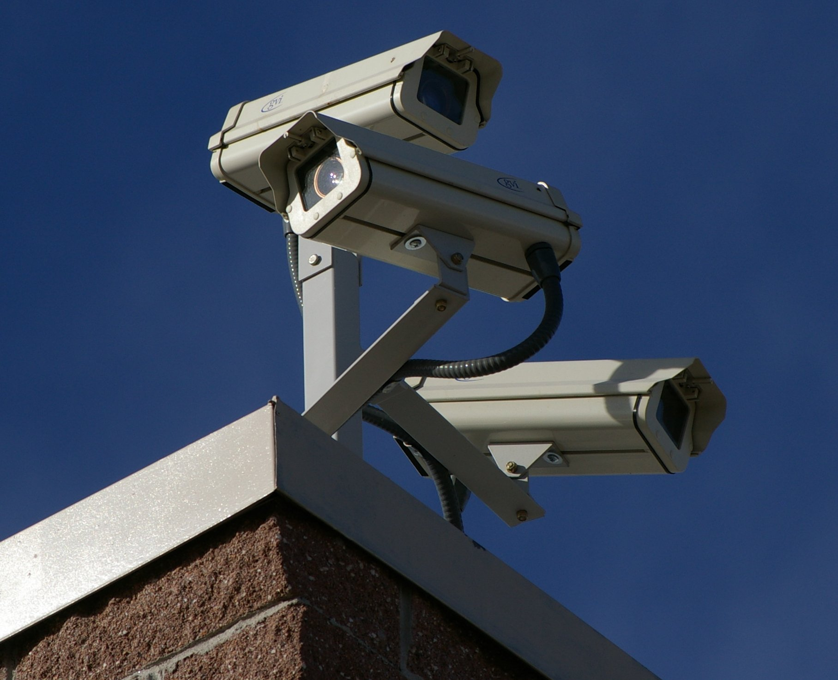
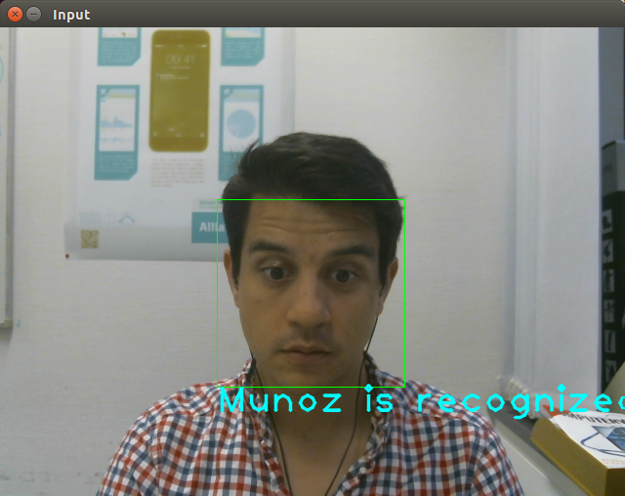
Non-invasive Smart Home System
images taken from wikipedia

Slide 10
Non-invasive Smart Home System
always on
on-demand
images taken from wikipedia

Slide 11
Proposed Solution
Build an non-invasive, extensible smart home system based on network intrusion detection techniques.

Slide 12









Extensible Smart Home System
Icons designed by Freepik

Slide 13

Extensible Smart Home System
Icons designed by Freepik

Slide 14
Proposed Solution
Build an non-invasive, extensible smart home system based on network intrusion detection techniques.

Slide 15





Based on Network Intrusion Detection Techniques
Icons designed by Freepik

Slide 16





Based on Network Intrusion Detection Techniques
Icons designed by Freepik

Slide 17
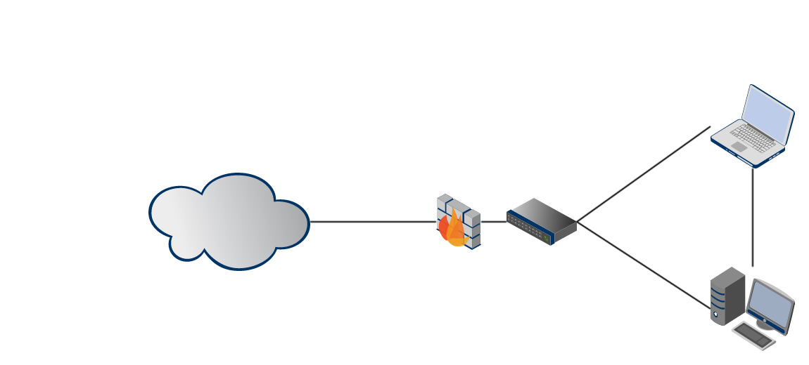
Based on Network Intrusion Detection Techniques

Slide 18



Based on Network Intrusion Detection Techniques

Slide 19










Based on Network Intrusion Detection Techniques

Slide 20
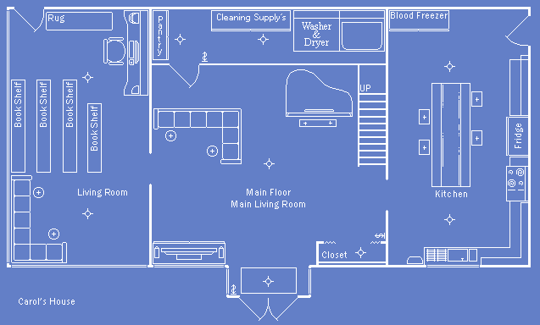





The Smart Home
http://r-g-characters.deviantart.com/art/Carol-s-House-BluePrints-141386651

Slide 21
http://r-g-characters.deviantart.com/art/Carol-s-House-BluePrints-141386651

Slide 22



Scenario

Slide 23


Scenario

Slide 24


Scenario

Slide 25

Scenario

Slide 26


Scenario

Slide 27
Scenario

Slide 28



Scenario

Slide 29
http://r-g-characters.deviantart.com/art/Carol-s-House-BluePrints-141386651

Slide 30
Problem Domain
http://r-g-characters.deviantart.com/art/Carol-s-House-BluePrints-141386651

Slide 31
Sensors
http://r-g-characters.deviantart.com/art/Carol-s-House-BluePrints-141386651

Slide 32
Actuators
http://r-g-characters.deviantart.com/art/Carol-s-House-BluePrints-141386651

Slide 33
Household
http://r-g-characters.deviantart.com/art/Carol-s-House-BluePrints-141386651

Slide 34
Household - Rooms
http://r-g-characters.deviantart.com/art/Carol-s-House-BluePrints-141386651

Slide 35
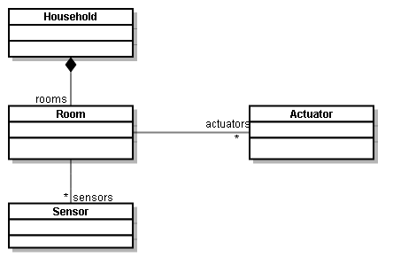
Object Model

Slide 36
The Guardian - Responsibilities
Take the sensor data
Interpret into information
Re/act according to knowledge

Slide 37
The Guardian - Responsibilities
Take the sensor data
Interpret into information
Re/act according to knowledge

Slide 38
Take the sensor data
{ Movement: ON }
{ Door: Open }
{ Presence: Off }
http://r-g-characters.deviantart.com/art/Carol-s-House-BluePrints-141386651

Slide 39
Interpret into Information
{ Presence: Off, Door: Opened, Movement: ON }
{ Possible Break-in }
http://r-g-characters.deviantart.com/art/Carol-s-House-BluePrints-141386651

Slide 40
Re/act according to knowledge
{ Possible Break-in, Usually no battery }
{ Turn camera on }
http://r-g-characters.deviantart.com/art/Carol-s-House-BluePrints-141386651

Slide 41
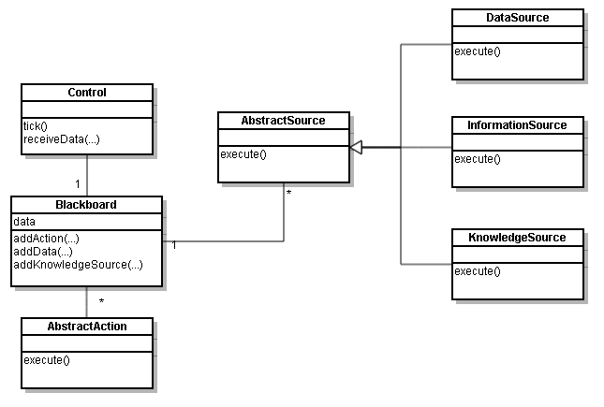
Blackboard

Slide 42
Blackboard

Slide 43
3 DataSources
{ Movement: ON }
{ Door: Open }
{ Presence: Off }
http://r-g-characters.deviantart.com/art/Carol-s-House-BluePrints-141386651

Slide 44
1 InformationSource
{ Presence: Off, Door: Opened, Movement: ON }
{ Possible Break-in }
http://r-g-characters.deviantart.com/art/Carol-s-House-BluePrints-141386651

Slide 45
1 KnowledgeSource
{ Possible Break-in, Usually no battery }
{ Turn camera on }
http://r-g-characters.deviantart.com/art/Carol-s-House-BluePrints-141386651

Slide 46
Blackboard

Slide 47
In the Blackboard
{ Movement: ON }
{ Door: Open }
{ Presence: Off }
{ Presence: Off, Door: Opened, Movement: ON }
{ Possible Break-in, Usually no battery }
Notes:
data and information are clearly and gut represented on the blackboard. Knowledge not so much.

Slide 48
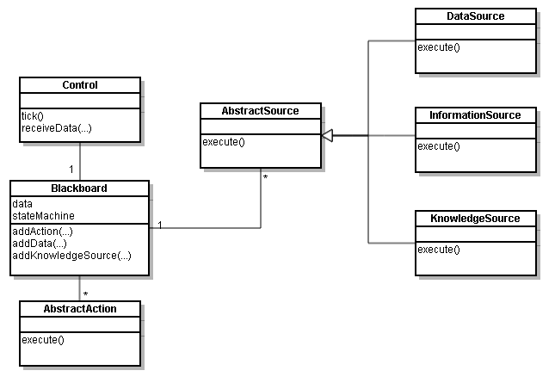
Blackboard… with a twist
Notes:
State machines are a way to represent knowledge. They also been used on different types of artificial intelligence agents.

Slide 49
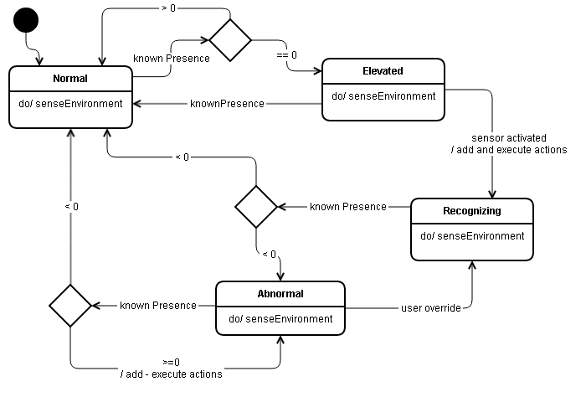
State machine - Threat Level

Slide 50
In the Blackboard
{ Movement: ON }
{ Door: Open }
{ Presence: Off }
{ Presence: Off, Door: Opened, Movement: ON }
{ Possible Break-in, Usually no battery }
{Current Threat Level: Elevated }

Slide 51
In the Blackboard
{ Movement: ON }
{ Door: Open }
{ Presence: Off }
{ Turn camera on }
{ Presence: Off, Door: Opened, Movement: ON }
{ Possible Break-in, Usually no battery }
{Current Threat Level: Elevated }

Slide 52
Demo

Slide 53
Proposed Solution
Build an non-invasive, extensible smart home system based on network intrusion detection techniques.

Slide 54
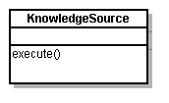
Anomaly Detection

Slide 55
Machine Learning
Preprocessing
When to training the model?
When to serve the model

Slide 56
Preprocessing
Common data model
Further preprocessing may be done on Data Sources

Slide 57
When to train the model?
Training
Trained Model
Time

Slide 58




When to train the model?
Training
Trained Model
Time

Slide 59




When to train the model?
Training
Trained Model
Time

Slide 60
When to train the model?
Training
Trained Model
Training
Trained Model
Time

Slide 61
When to train the model?
Time

Slide 62
When to train the model?
No functionality
Training
Trained Model
Time

Slide 63
When to train the model?
Training
Trained Model
???????
Training
Trained Model
Time

Slide 64
When to train the model?
Training
Trained Model
State-Machine Based
Training
Trained Model
Time
Notes:
state machine is rule-based

Slide 65
Technologies Used
OpenHAB
Robot Operating System

Slide 66
Next steps
Finish model selection
Train and test model
Evaluate model
Finish document

Slide 67
Thank you, and have a great vacation!

Slide 68
Backup Slides

Slide 69
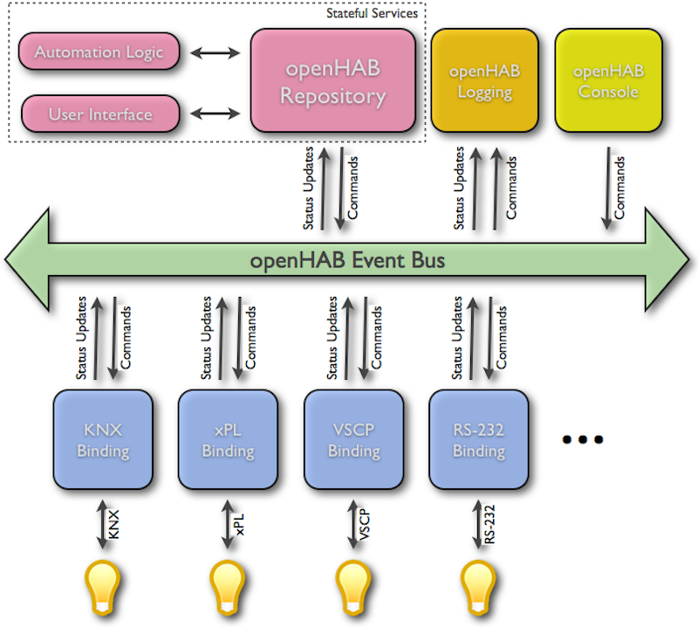
OpenHAB

Slide 70
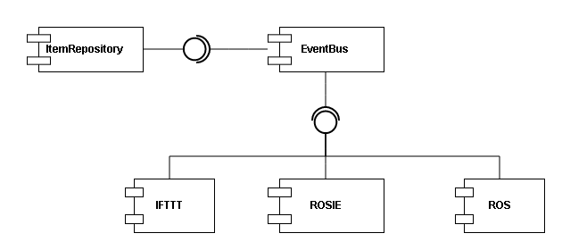
Component Diagram

Slide 71
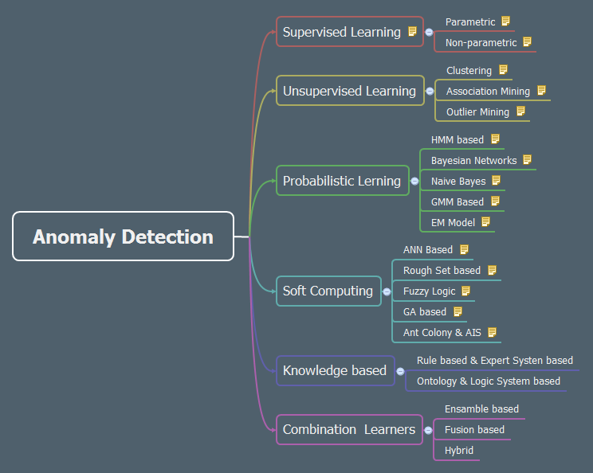
Intrusion detection algorithms

Slide 72
Intrusion detection algorithms

Slide 73
http://r-g-characters.deviantart.com/art/Carol-s-House-BluePrints-141386651

Slide 74

Extensible Smart Home System
Icons designed by Freepik

